Slide 1
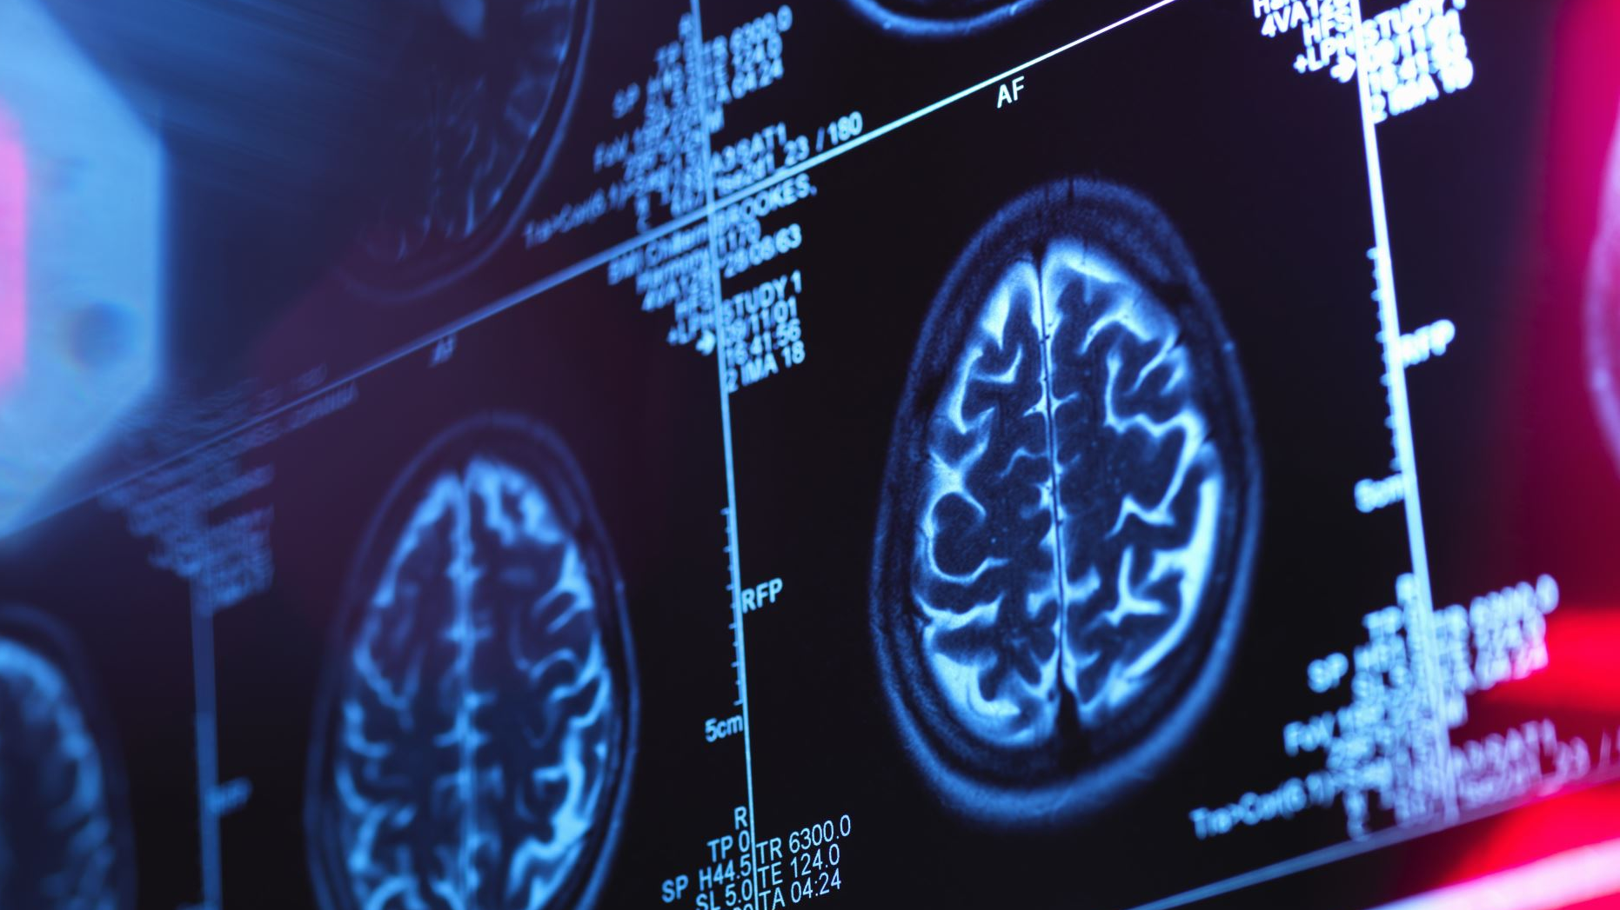

CAROTID SONOGRAPHY FINDINGS IN PATIENTS WITH CEREBRAL SMALL VESSEL DISEASE
Dr Stefan Stoisavljevic

Slide 2
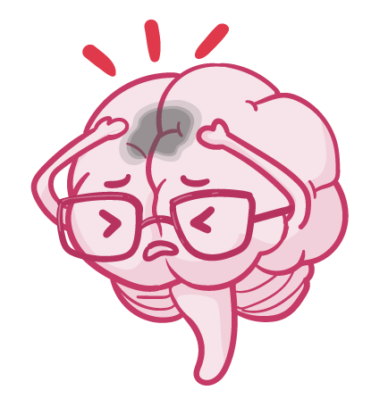

What is cerebral small vessel disease?
A group of pathological processes of different etiologies that affect small arteries, arterioles, venules, and capillaries of the brain.
Atherosclerosis and cerebral amyloid angiopathy are the most common causes.
Most common neuroimaging manifestations of CSVD:
  ischemic lesions such as lacunar strokes (LS)
  white matter hyperintensities (WMH)

Slide 3

Lacunar strokes
Barkhof, F., Jäger, H. R., Thurnher, M. M., & Rovira, À. (2019). Clinical Neuroradiology: The ESNR Textbook, p. 178

Slide 4

White matter hyperintensities
Shen, W. (2020). Diagnostic Neuroradiology: A Practical Guide and Cases, p. 184

Slide 5
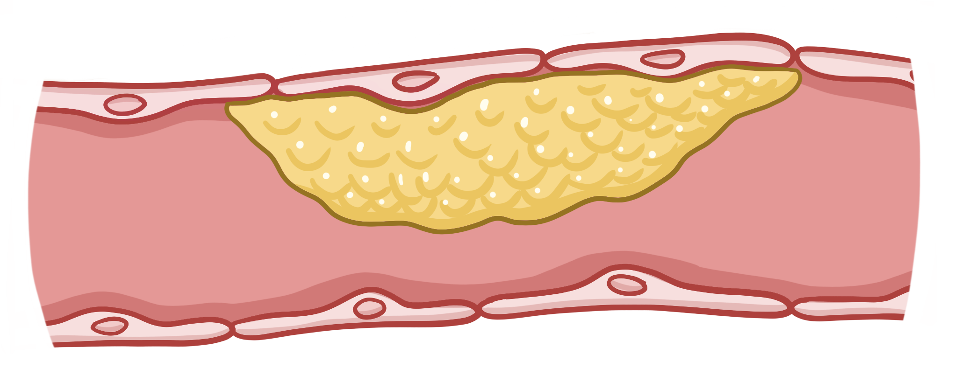

What is atherosclerosis?
Atherosclerosis is a chronic disease of the arteries defined by inflammation and plaque forming in the wall of the affected arteries.
That eventually causes stenosis of the vessel.
Carotid artery stenosis is considered the most common single cause of an ischemic event.

Slide 6
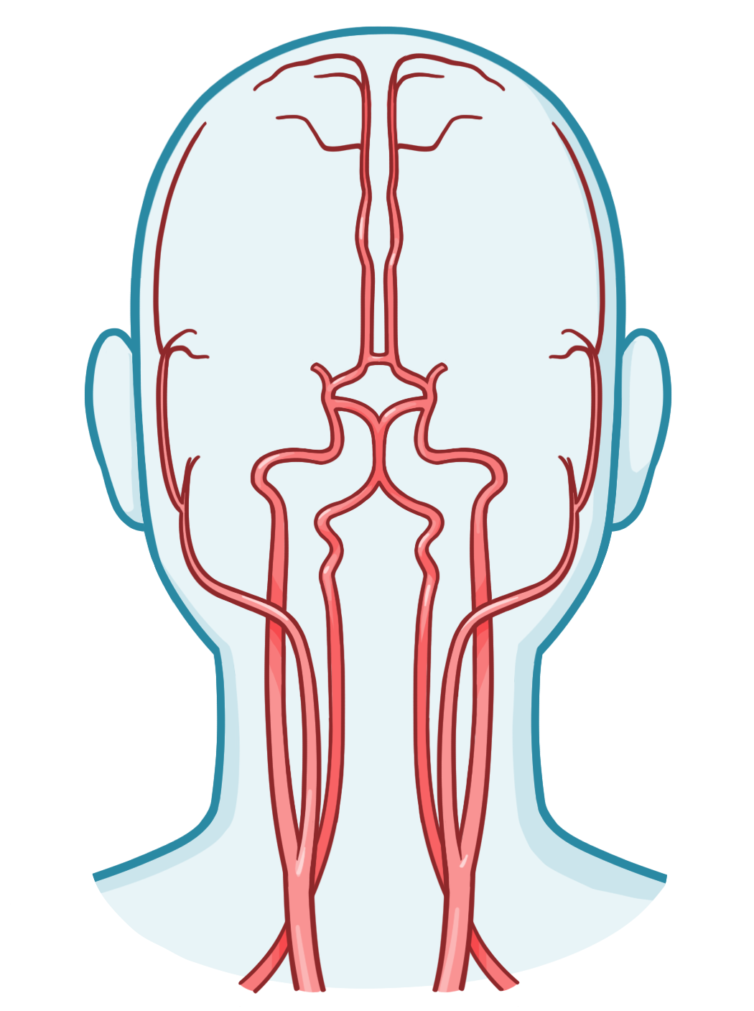
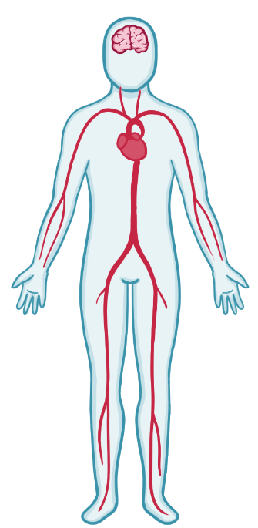


Large vessel pathology & CSVD?
Clear morphological and functional connection between large and small cerebral arteries.
Atherosclerosis is a systemic disease.
There are only a few studies on the subject, but their conclusions differ.

Slide 7


The aim
The aim of this cross-sectional retrospective study is to determine the frequency, type and the degree of atherosclerotic occlusive pathology of large extracranial cerebral blood vessels (carotid and vertebral arteries), using extracranial color duplex sonography, in patients with clinically and neuroimaging verified atherosclerotic CSVD.

Slide 8


Material and methods
99 patients treated at the Neurology Clinic of the Clinical Center of Serbia in Belgrade, from November 2018. to August 2021.
Inclusion criteria:
  Clinically and neuroimaging confirmed CSVD
  Extracranial color duplex sonography examination
Exclusion criteria:
  ischemic stroke caused by atherosclerosis of the large cerebral blood vessels
  cardio-embolic stroke
  presence of other non-vascular brain lesions (i.e. tumors)
  inadequate color duplex sonography

Slide 9
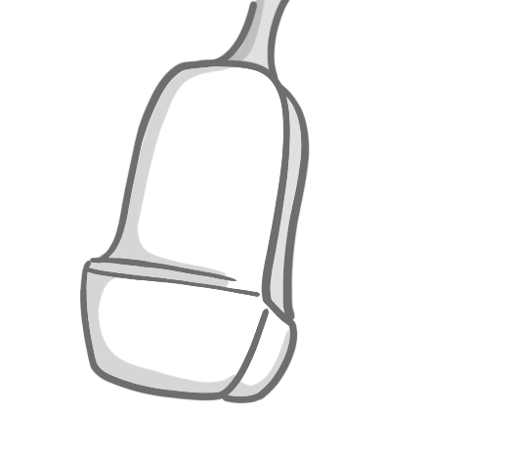

Material and methods
Ultrasonography findings:
  The presence of plaques in carotid arteries and its characteristics (echogenicity, morphology, stability) and the degree of carotid diameter stenosis according to the combined criteria [14];
  Sum of carotid stenosis – calculated by summation of the carotid diameter stenosis calculated in percentages of the left and right carotid artery;
  Intima-media thickness (IMT, mm) of the carotid arteries, measured according to the Mannheim consensus, in the common carotid artery, 2 cm from the carotid bifurcation [13];
  IMT sum – calculated by summation of IMT of the left and right carotid artery;
  Anatomic variations of the internal carotid arteries (ICA) (kinking, coiling, angulation);
  ICA peak systolic velocity (PSV) and end diastolic velocity (EDV);
  Vertebral artery (VA) characteristics (the presence of stenotic plaque, hypoplasia, and low flow);
  AV peak systolic velocity (PSV) and end diastolic velocity (EDV).
Valdueza, J. M., & Schreiber, S. J. (2011). Neurosonology and Neuroimaging of Stroke, p.76

Slide 10
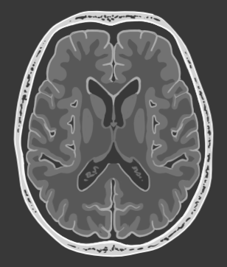


Material and methods
Neuroradiological findings:
  Type of lesion (lacunar stroke, white matter hyperintensities)
  Lesion localization (right, left, bilateral)
Cerebrovascular risk factors:
  Hypertension – defined as a systolic blood pressure ˃ 140 mmHg, diastolic blood pressure ˃ 90 mmHg, use of anti-hypertensive medication or history of hypertension;
  Diabetes mellitus – defined as previously diagnosed, or the use of anti-diabetic medication;
  Dyslipidemia – defined as total cholesterol levels ˃ 5.2 mmol/l, and/or triglyceride levels ˃ 1.7 mmol/l;
  Smoking – defined as self-reported smoker or non-smoker.

Slide 11


Material and methods
Statistical analysis (SPSS ver.26)
Testing for normality of distribution (coefficient of variation, skewness, kurtosis, Shapiro-Wilk test)
Testing for statistical difference between variables (Chi square test, ANOVA)

Slide 12

Basic demographic and risk factor characteristics of our patients
 | patients n=99
age, mean | 64.3 ± 10.5
male | n=41 (41.4%)
female | n=58 (58.6%)
hypertension | n=87 (87.9%)
elevated cholesterol | n=32 (32.3%)
elevated triglycerides | n=23 (23.2%)
diabetes | n=27 (27.3%)
smoking | n=45 (45.5%)

Slide 13

Our patients according to the degree of carotid diameter stenosis
ICA – internal carotid artery

Slide 14

Our patients according to lesion localization

Slide 15

Results of statistical analysis
Type of lesion
Lesion localization
Gender
Age
IMT right
IMT left
IMT total
ICA stenosis
Right ICA stenosis
Right ICA stenosis %
Left ICA stenosis
Left ICA stenosis %
Stenosis sum %
Kinking/coiling right
Kinking/coiling left
Right ICA PSV
Right ICA EDV
Left ICA PSV
Left ICA EDV
Right VA stenosis
Left VA stenosis
Right VA hypoplasia
Left VA hypoplasia
Right VA PSV
Right VA EDV
Left VA PSV
Left VA EDV

Slide 16

Results of statistical analysis
Type of lesion
Lesion localization
Gender
Age
IMT right
IMT left
IMT total
ICA stenosis
Right ICA stenosis
Right ICA stenosis %
Left ICA stenosis
Left ICA stenosis %
Stenosis sum %
Kinking/coiling right
Kinking/coiling left
Right ICA PSV
Right ICA EDV
Left ICA PSV
Left ICA EDV
Right VA stenosis
Left VA stenosis
Right VA hypoplasia
Left VA hypoplasia
Right VA PSV
Right VA EDV
Left VA PSV
Left VA EDV

Slide 17

Results of statistical analysis
 | N | age
 |  | min | max | mean
LS | 51 | 38 | 78 | 61
WMH | 48 | 42 | 87 | 68
 | AGE
TYPE OF LESION | p<0.01
LS – lacunar stroke
WMH – white matter hyperintensities

Slide 18


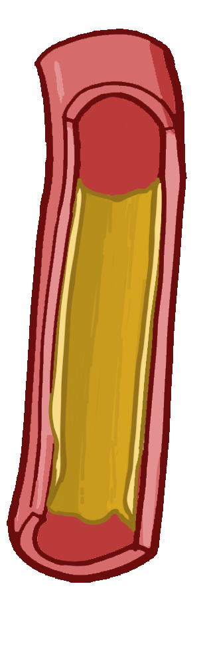


Conclusion
Correlation between aging and CSVD was found!
1
No correlation between other risk factors/carotid ultrasonography findings and CSVD.
2
Is clinically insignificant stenosis truly insignificant?
3

Slide 19
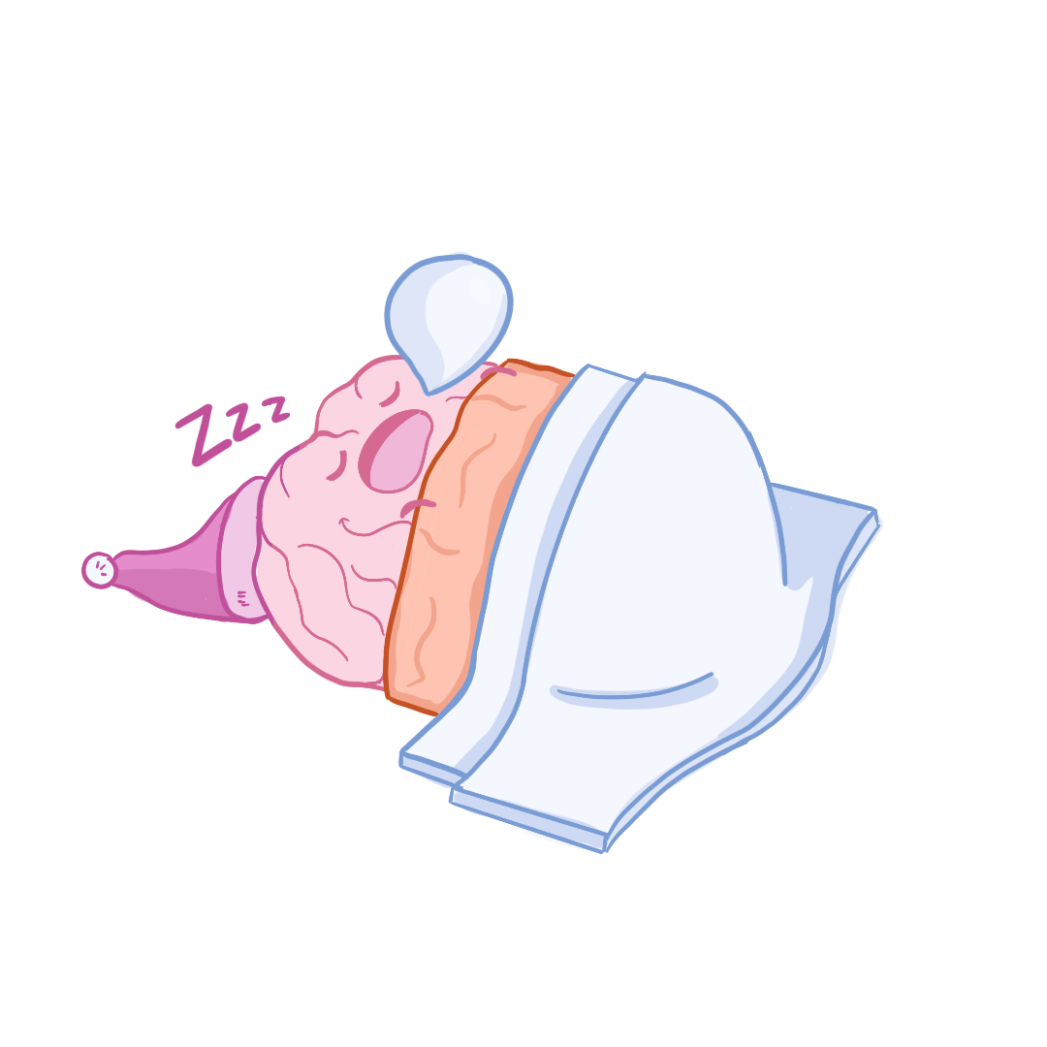

THANK YOU!

